Slide 1

Loan Status Prediction Python with Machine Learning
ANKIT KUMAR
CUSB2102312010
SEMESTER: 4TH SEM
SESSION: 2021-23
Guided by: Mr Rakesh Kumar Jha
IIHT Gurgoan(Hariyana)

Slide 2
Table of Content: 1. Introduction 2. Problem Statement 3. Solution 4.Machine Learning 5.Hardware & Software Used 6.Implementation of Model 7. Importing of Dataset 8.Training the Model 9.Save the Model 10.Check the Model 11.Conclusion 12.Refrences

Slide 3
1.Introduction of Loan Predication
Loan is essential part of the lending process.
Core Business of banks.
Main Profit comes directly from the loan’s interest.
Faced on financial Institutions such as Bank, credit Unions and other lending organization.
Accurate Predication helps minimize risks & Make better lending decision.

Slide 4
2. Problem Statement
Old systems were made using Java, so needed to install a device.
It didn’t provide feature of online Backup.
Lot of Human resource required.
More time consuming on verification Process.

Slide 5
3. Solution
Our Machine Model calculates all parameters given and if the application eligible loan or not in very less time.
Uses of Machine Learning Algorithm.

Slide 6
It is a subset of Artificial Intelligence.
It performs on Scientific study of algorithm.
It is used in Statistical models with computer systems.
Importance of Machine Learning:
→ Fraud Detection
→ Better Decision making
→Medical Diagnosis & Treatment etc.
4. Machine Learning

Slide 7
Machine Learning
Input data is not labeled, but goal is discover meaningful data.
Ex:- Market basket analysis etc.
Supervised Learning
Unsupervised Learning
Learns to make predications based on Labeled training data.
Ex:- Spam Detection, Risk assessment etc.
→ Reinforcement Learning:- Used in Robotics & game playing.

Slide 8
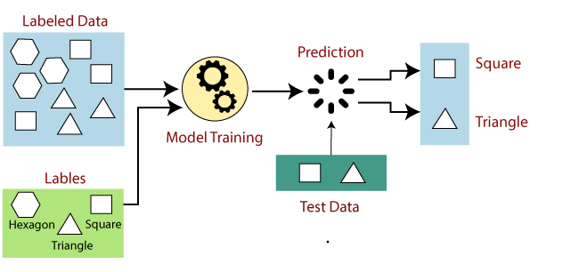
Supervised Learning

Slide 9
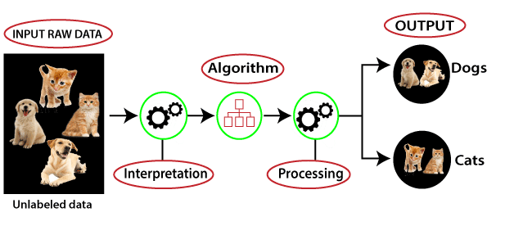
Unsupervised Learning
( Identify Hidden Pattern: Relevant features or characteristics from the data, structures of data or relationships of data etc.)

Slide 10
5.Hardware & Software Used
Hardware Used:
→ Windows 10
Software/ Code Editor Used
→ JupiterLite, Google colab
Libraries used( Python Language)
→ Pandas → Matplotlib & Seaborn
→ NumPy → SKlearn

Slide 11
Libraries used( Python Language)
High Level Language
Interpreted Language
Easy to learn and simple syntax.
Developed by: Guido van Rossum(1990s)
3.11.2 latest release of the python.
Collection of pre-written code and functionalities.
Used to perform scientific task or solve scientific problems.

Slide 12
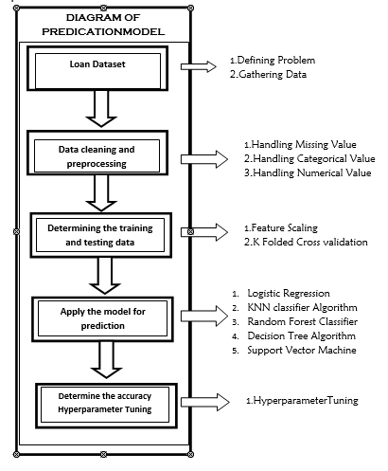
6. Implementation
of Model

Slide 13
7. Importing of Dataset
Pandas in python provide an interesting method read_csv().
The read_csv function reads the entire dataset from a comma separated values(CSV) file.
Each and every value can be access using the data frame.
Any missing value or NaN value have to be cleaned.

Slide 14
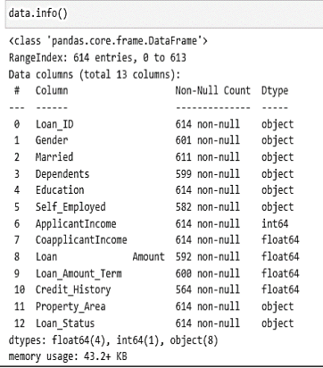
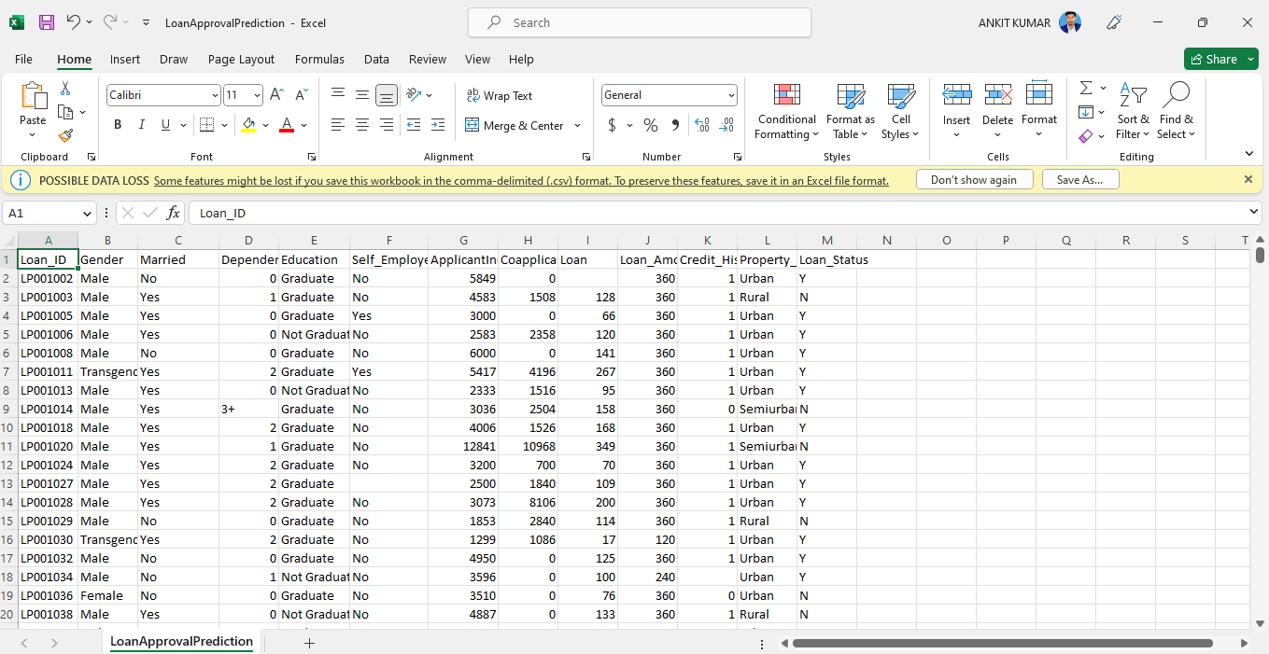
* Dataset & Information*

Slide 15
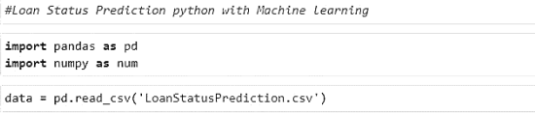
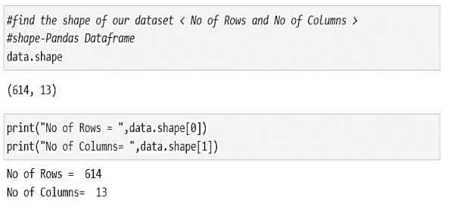
Reading the Dataset using Notebook:
→data.head(5)
→data.tail(5)
→data.shape()

Slide 16
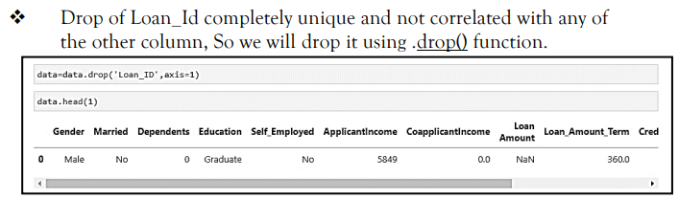
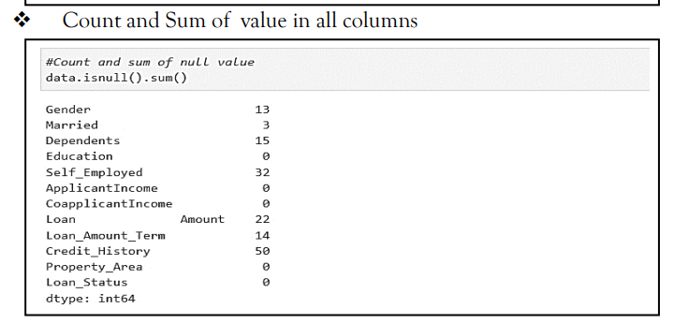
Handling the Missing Value

Slide 17
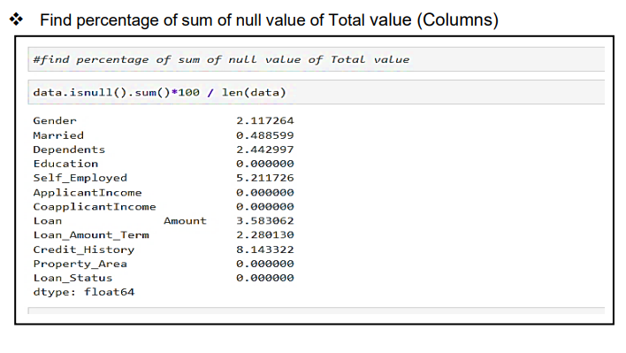

Slide 18
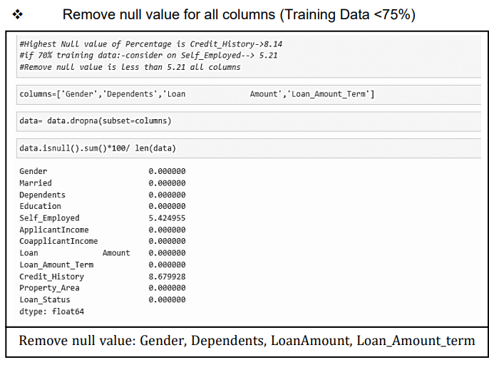

Slide 19
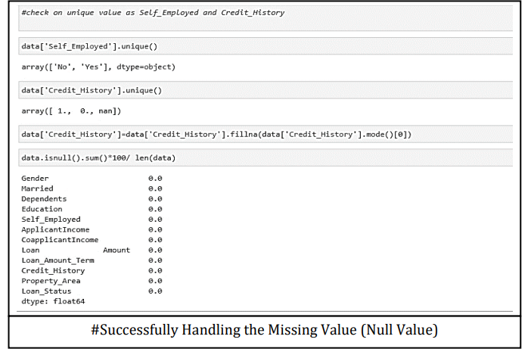

Slide 20
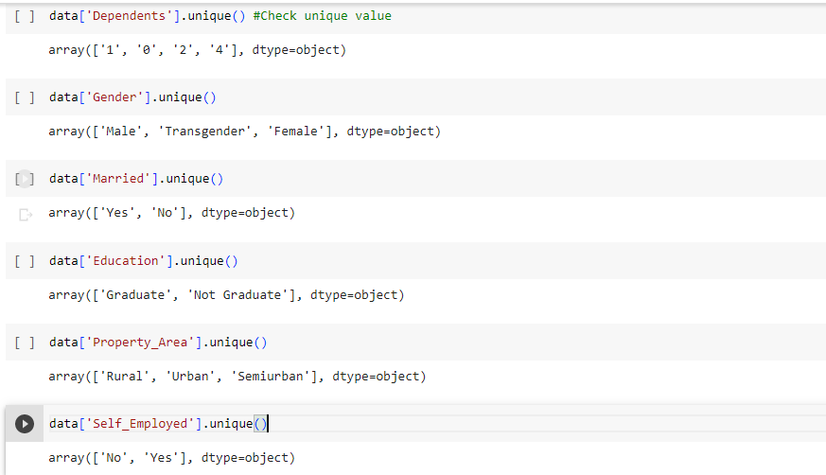
Handling the Categorical Data

Slide 21
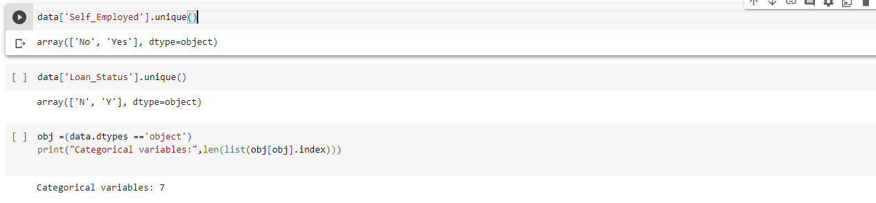
Successfully Handling the Categorical Data

Slide 22
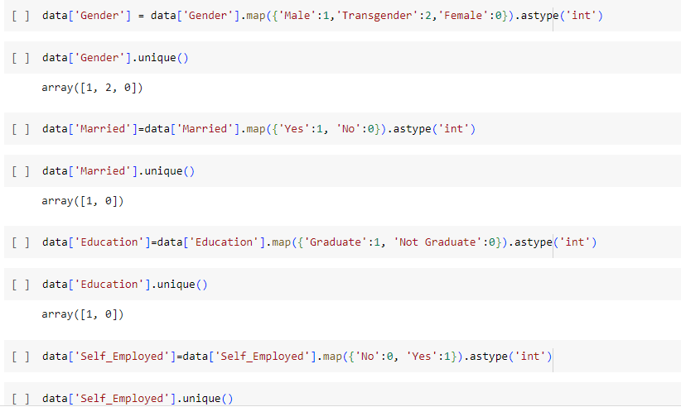
Handling the Numerical Data

Slide 23
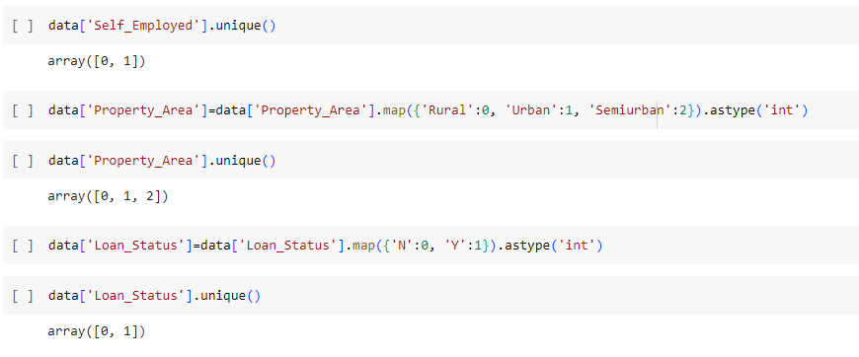

Slide 24
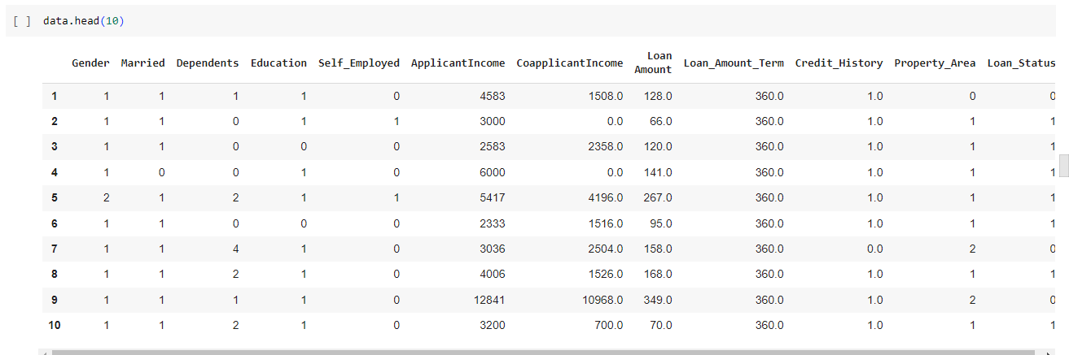
Successfully Handling Numerical Data

Slide 25
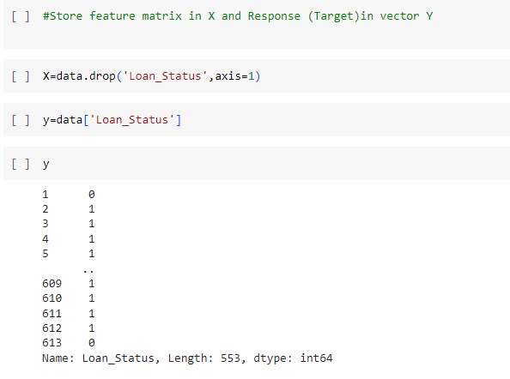

Slide 26
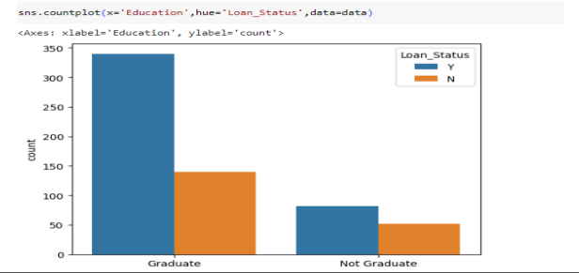
→ Data Visualization

Slide 27
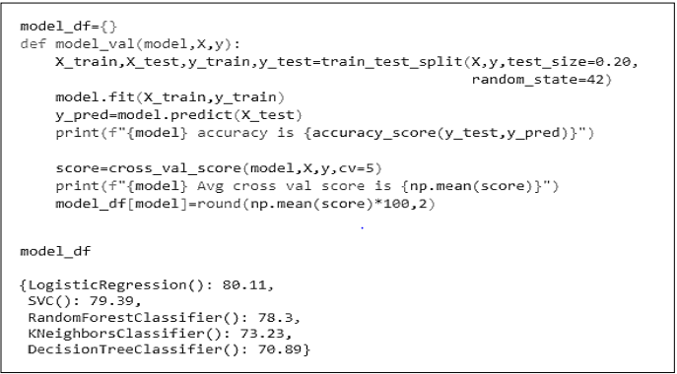
8. Training the Model

Slide 28
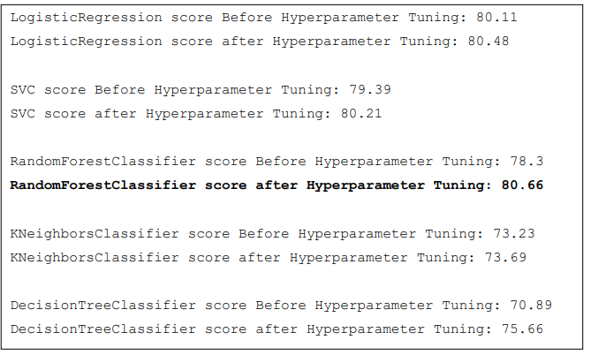
HyperParameter Tuning
Process of selecting the optimal values for the hyperparameters of a machine learning model.
Tuning:- Achieve good performance of model

Slide 29
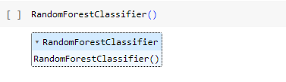
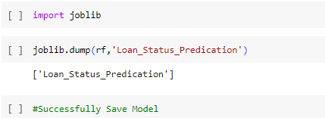
9. Save the Model

Slide 30
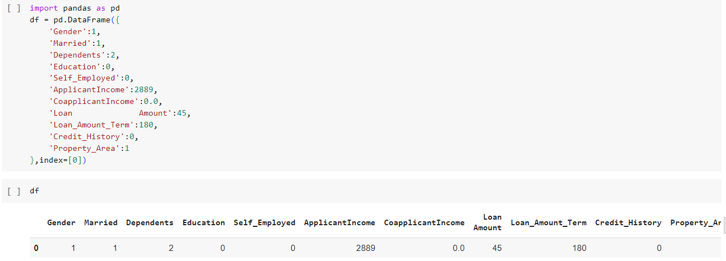
10.Check the Model

Slide 31
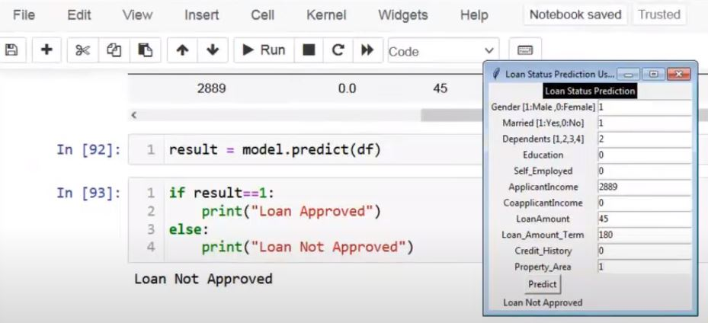
* Check the Model

Slide 32
11.Conclusion
→The loan application system approves or rejects loan applications.
➔ Machine learning models are valuable for predicting outcomes with large datasets.
➔ In our project, We utilized five machine learning algorithms are used as Logistic regression, support vector machines, random forest classifiers, KNN classifiers, and decision trees to predict loan approval for customers.
➔ Based on experimental results, the random forest classifier algorithm exhibited the highest accuracy among the four algorithms.

Slide 33
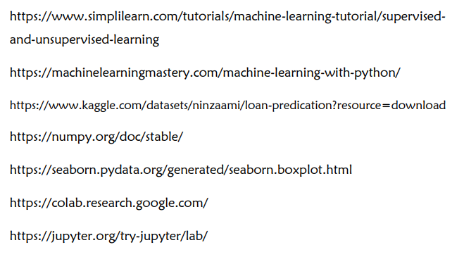
12.Refrences

Slide 34

THANK YOU

